Slide 1


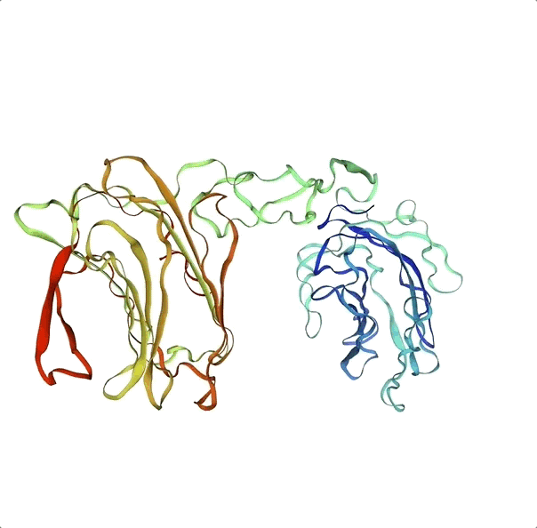
Yasemin Utkueri - Berk Turhan - Zeynep Kılınç - Deniz Küçükahmetler

Slide 2
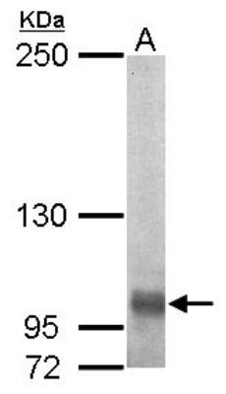
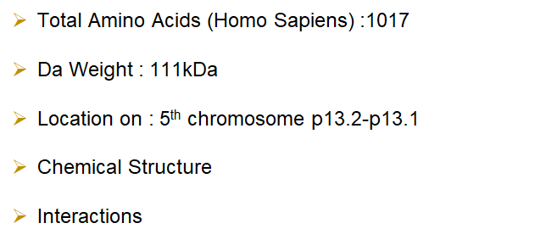
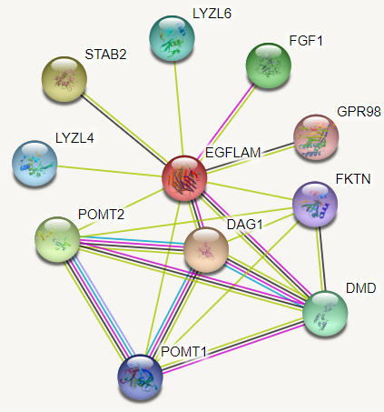
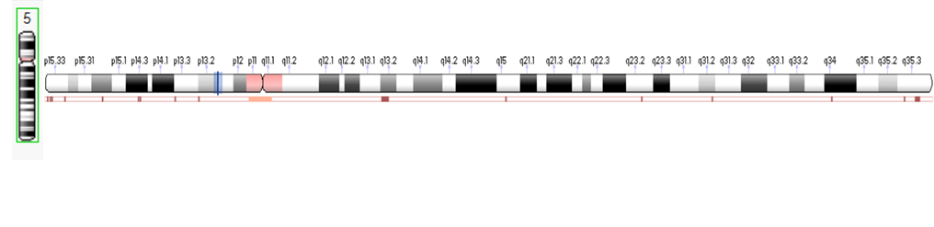
Introduction

Slide 3
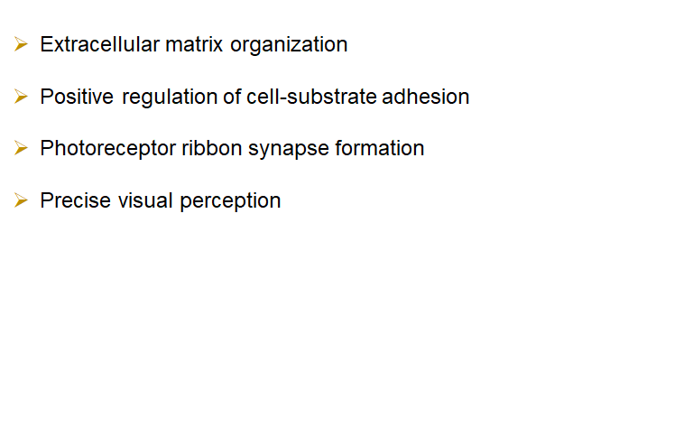
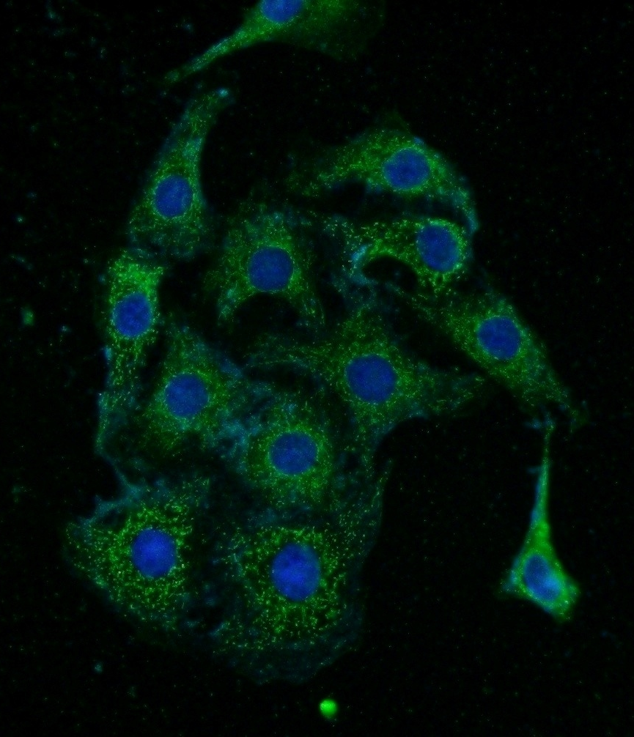
Function

Slide 4
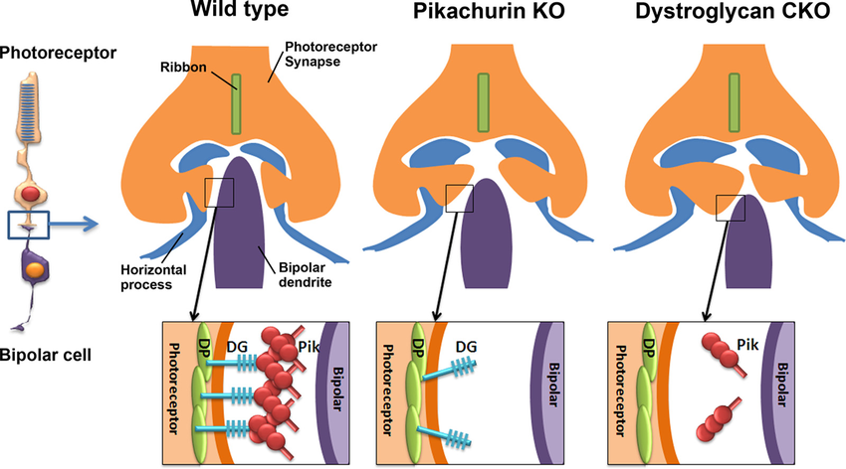
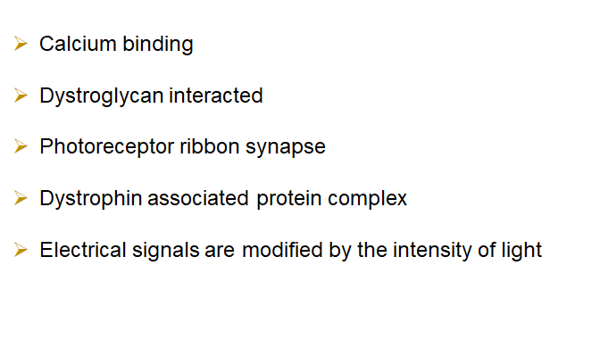
Functional Process

Slide 5
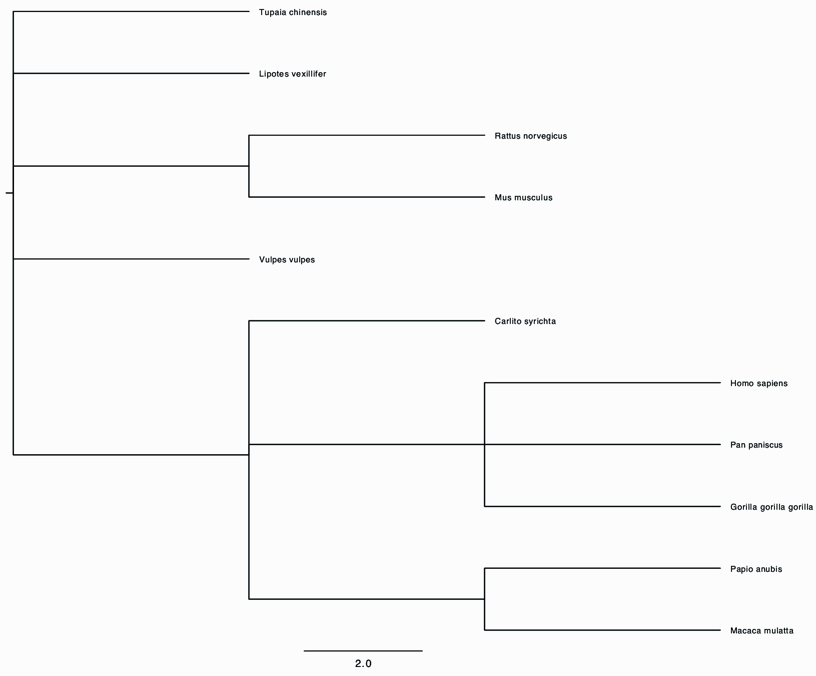
Results
Tupaia chinensis
Lipotes vexillifer
Rattus norvegicus
Mus musculus
Vulpes vulpes
Carlito syrichta
Homo sapiens
Pan paniscus
Gorilla gorilla gorilla
Papio anubis
Macaca mulatta

Slide 6
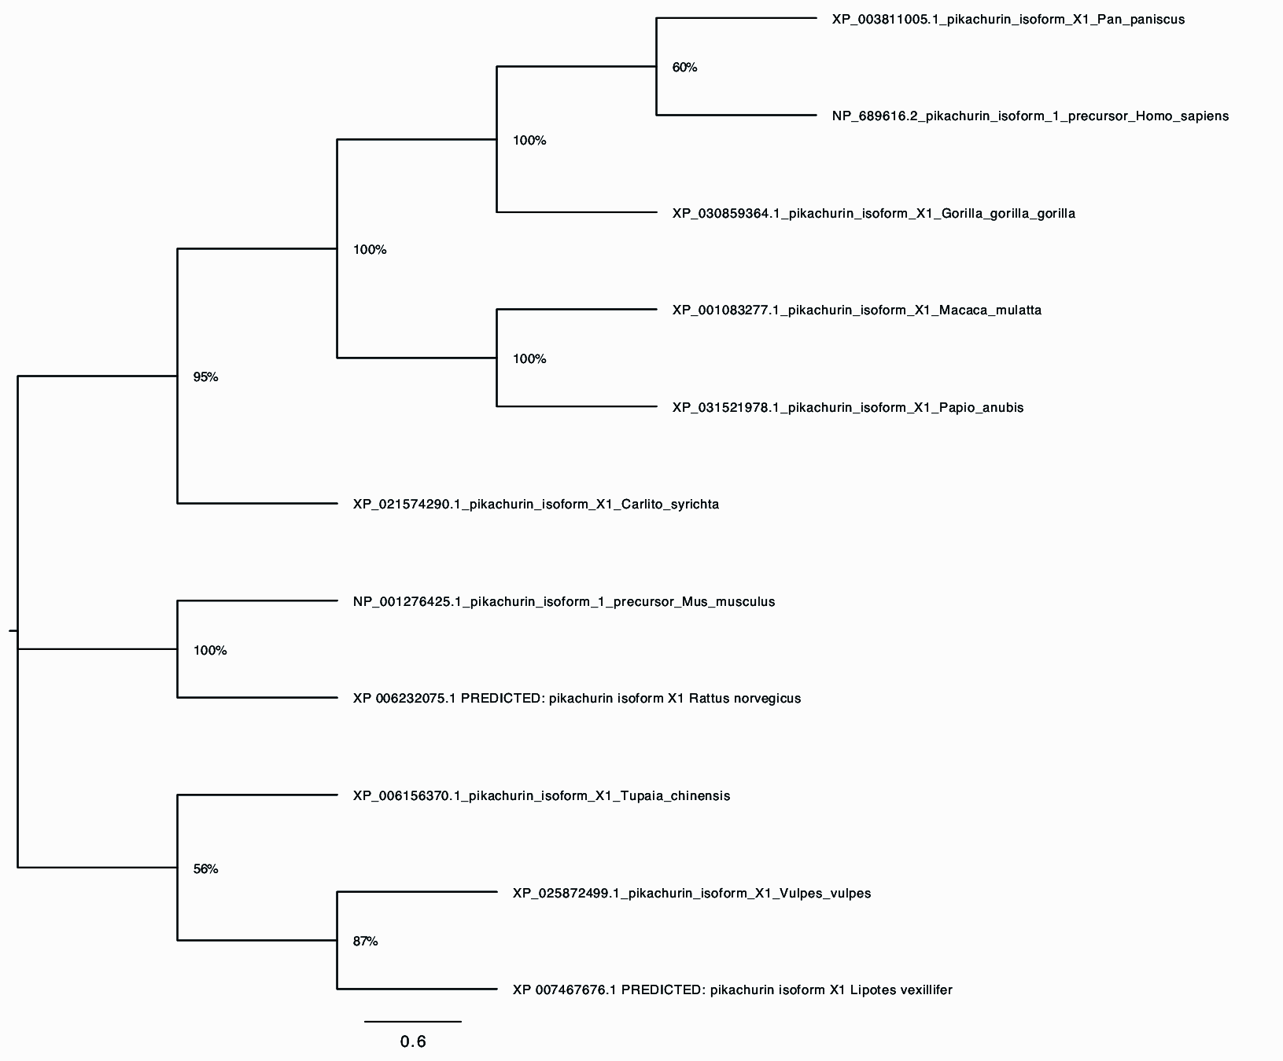
Pan paniscus
Homo sapiens
Gorilla gorilla gorilla
Macaca mulatta
Papio anubis
Carlito syrichta
Mus musculus
Rattus norvegicus
Tupaia chinensis
Vulpes vulpes
Lipotes vexillifer

Slide 7
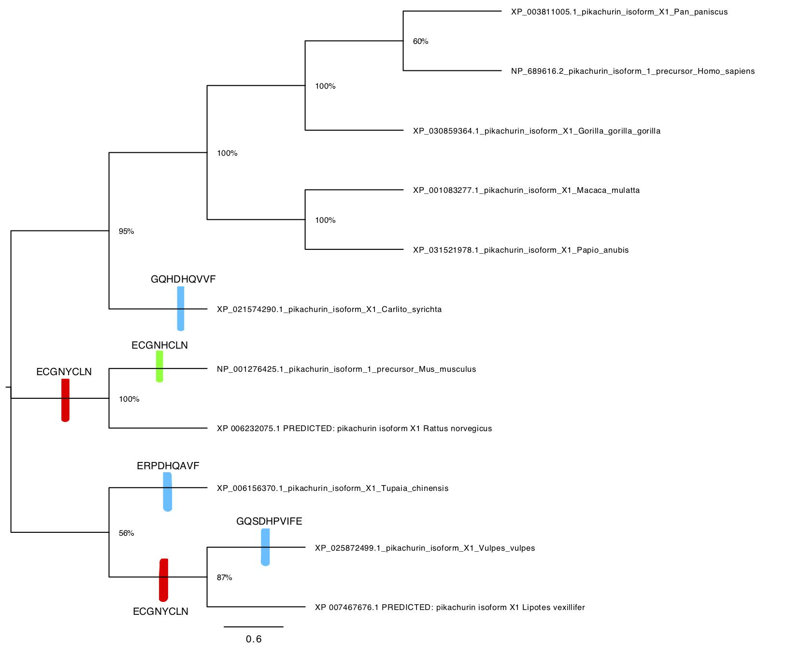
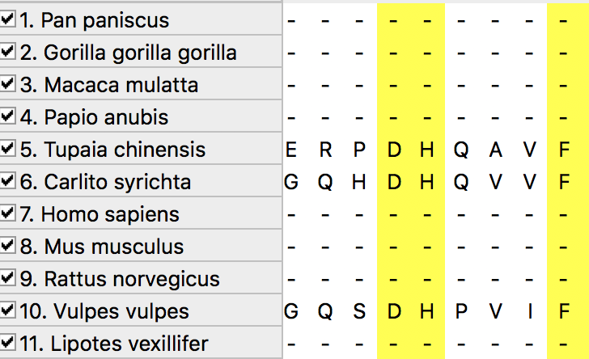
Carlito syrichta
Tupaia chinensis
98-106
Vulpes vulpes

Slide 8
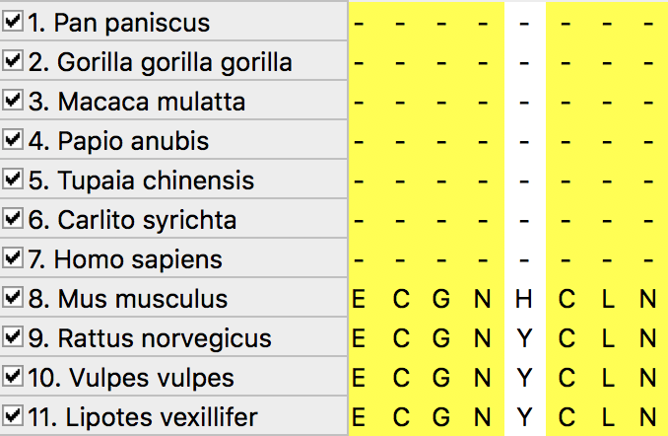
Mus musculus
Rattus norvegicus
831-838
Vulpes vulpes
Lipotes vexillifer

Slide 9
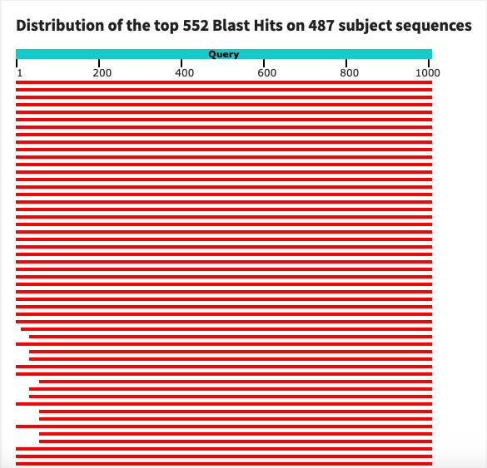
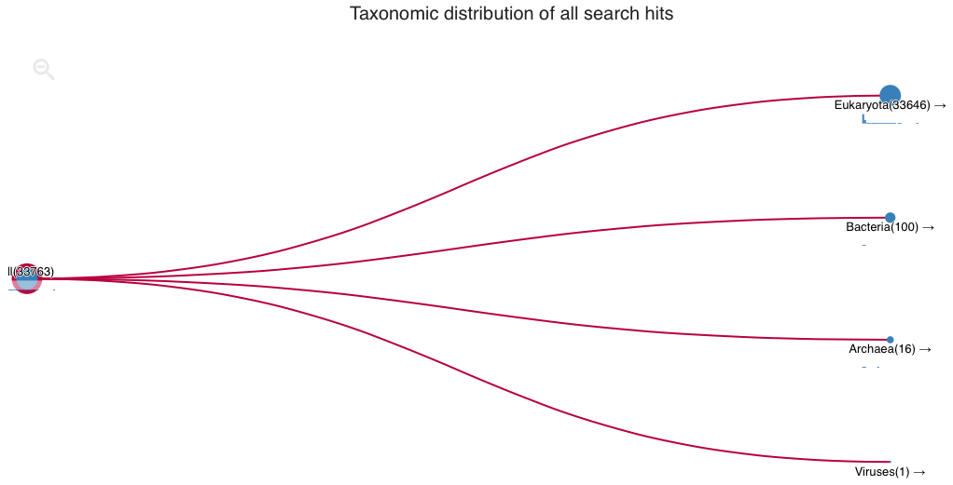
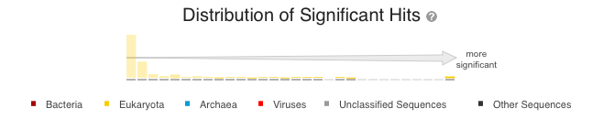

Slide 10
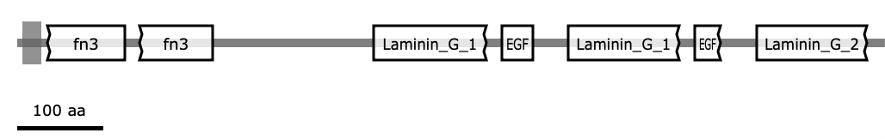
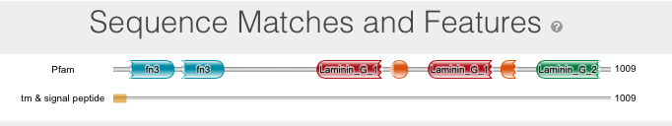
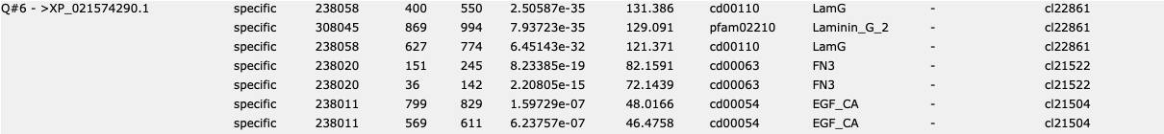
CDVIST
Jackhmmer
NCBI Conserved Domain Search Tool

Slide 11
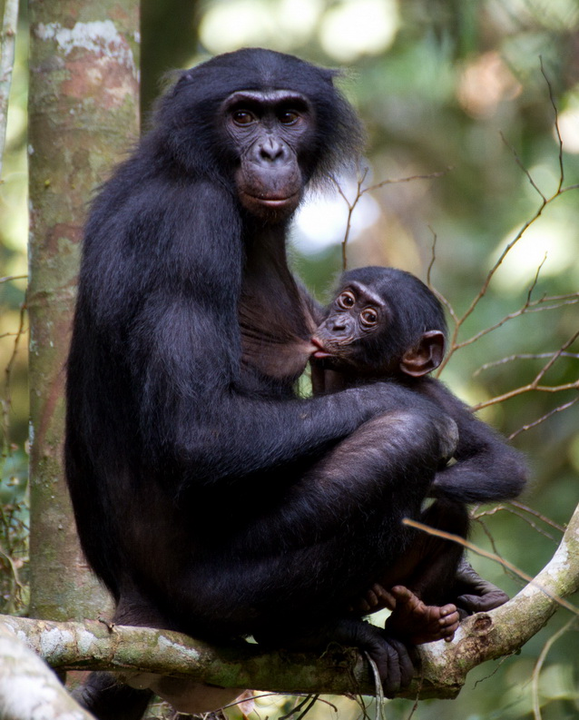
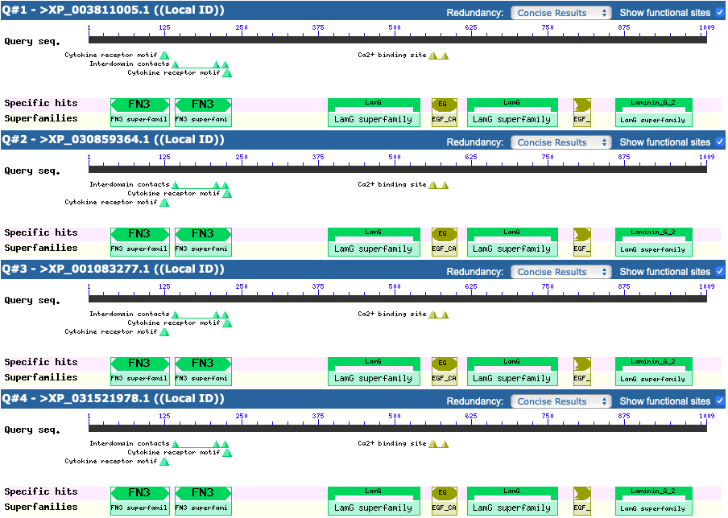
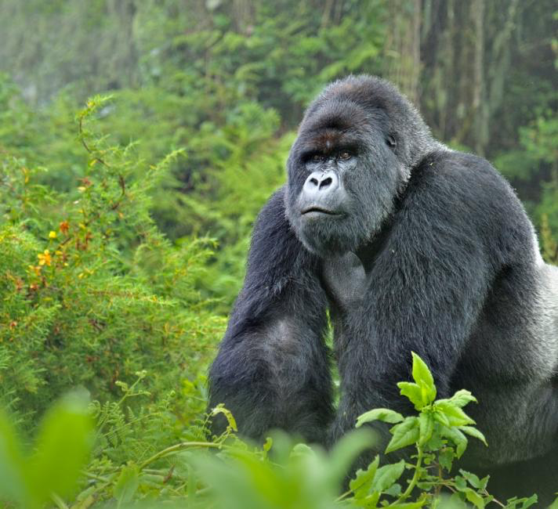

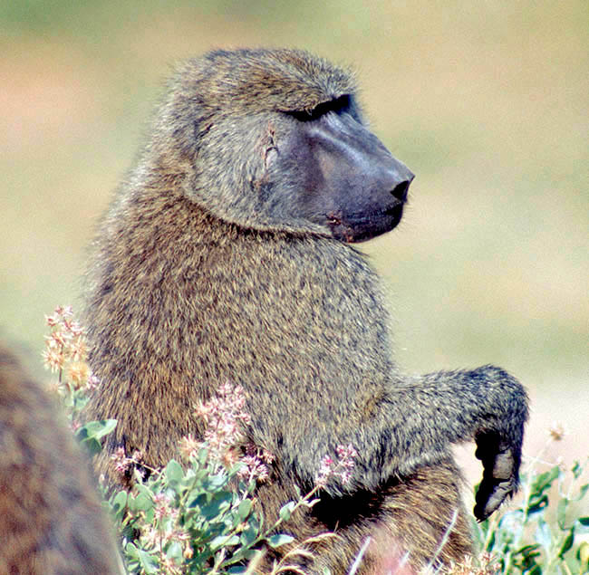
NCBI Conserved Domain Search Tool Graphs

Slide 12
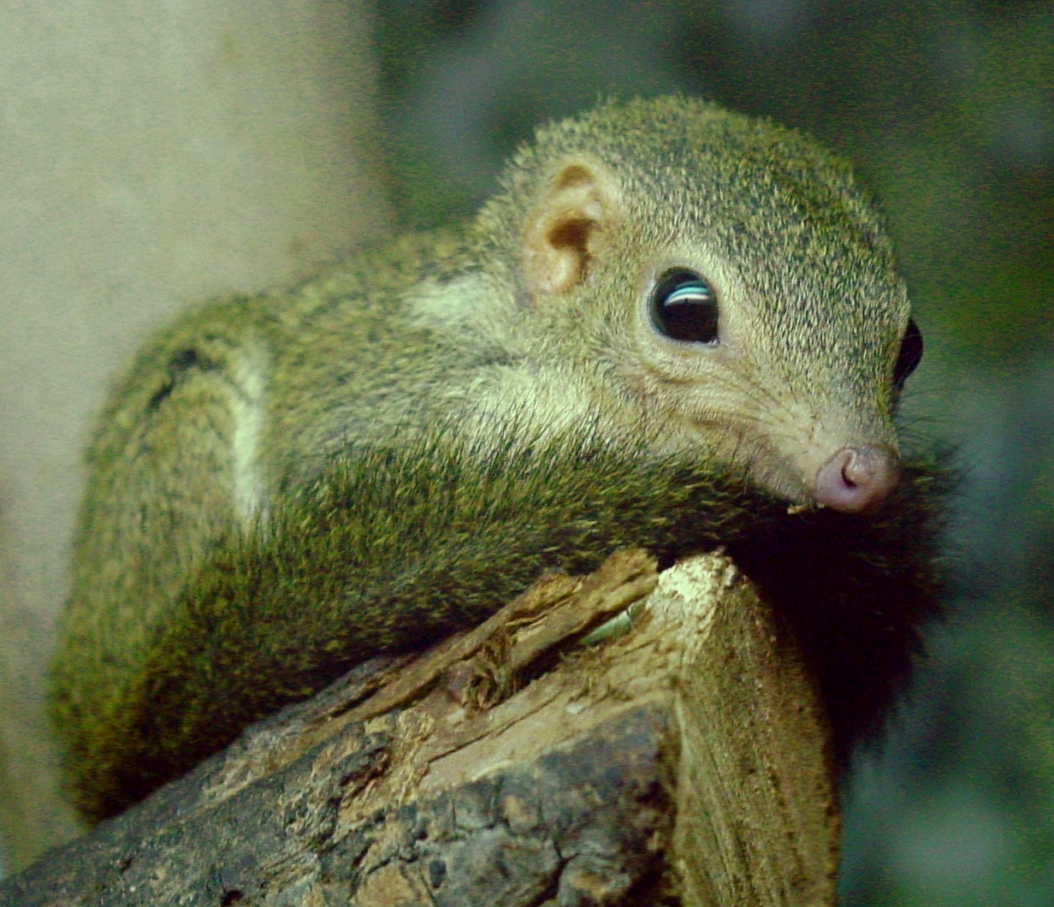
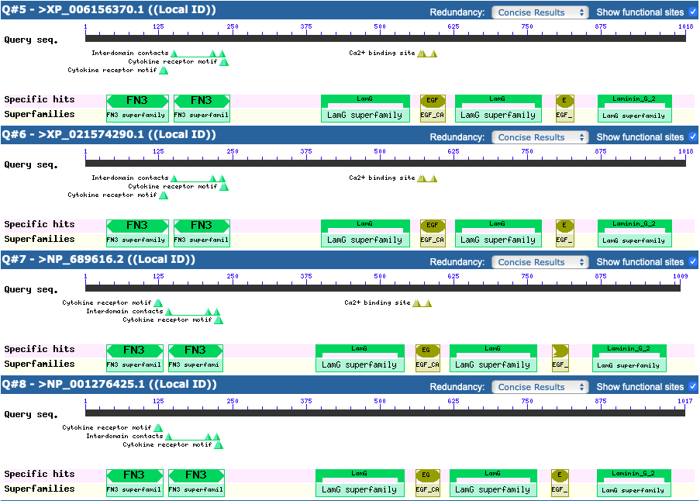




Slide 13
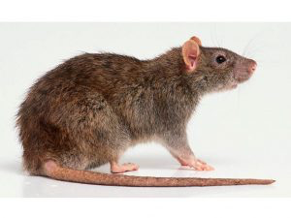
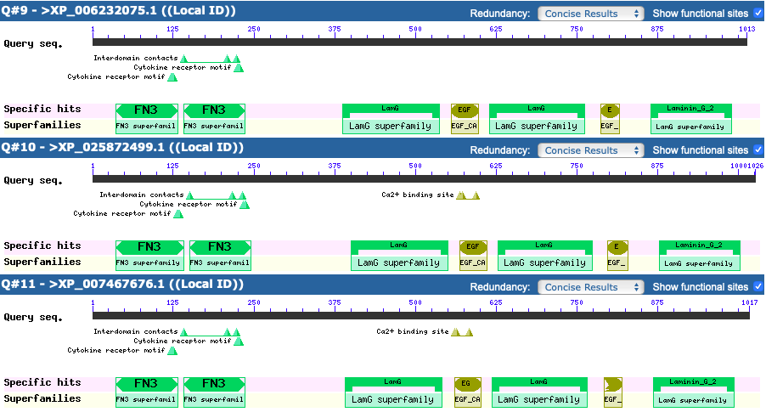

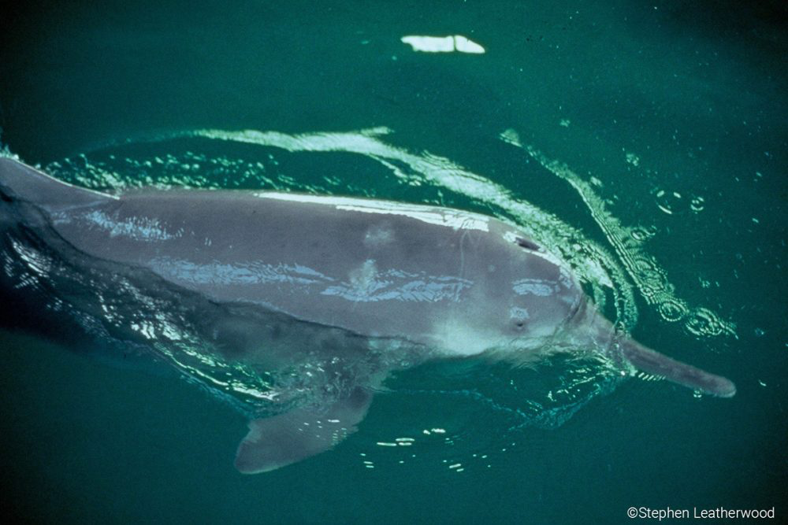
Google+

Slide 14
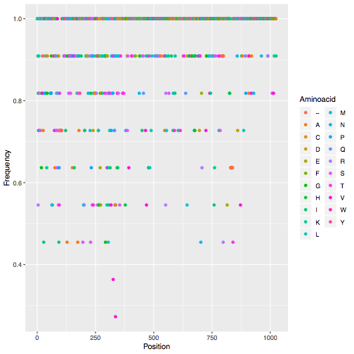

Slide 15
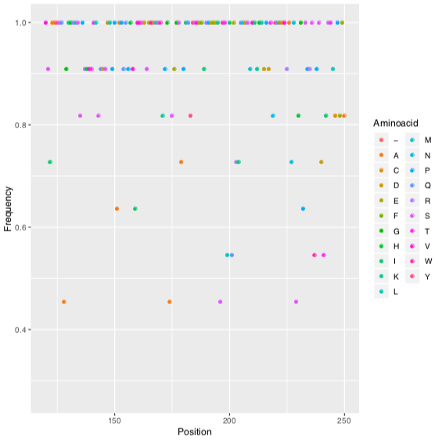

Slide 16
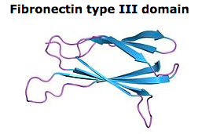
Binds to:
Calcium
Proteins
Glycosaminoglycan

Slide 17
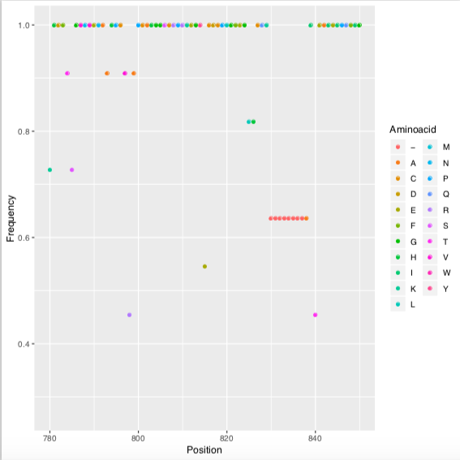

Slide 18
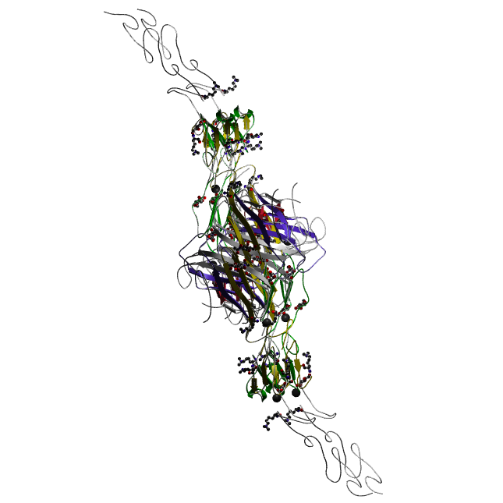
EGF_CA Domain

Slide 19
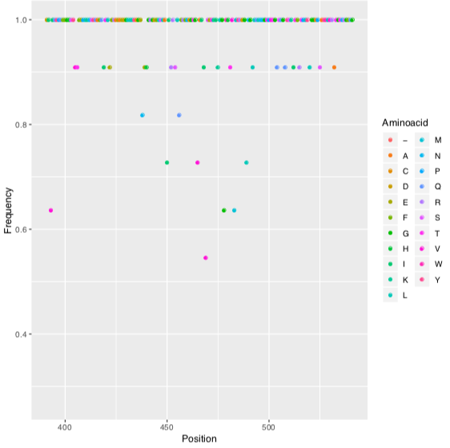

Slide 20
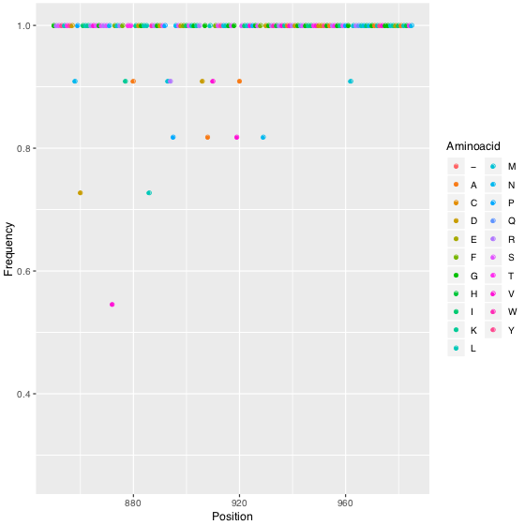

Slide 21
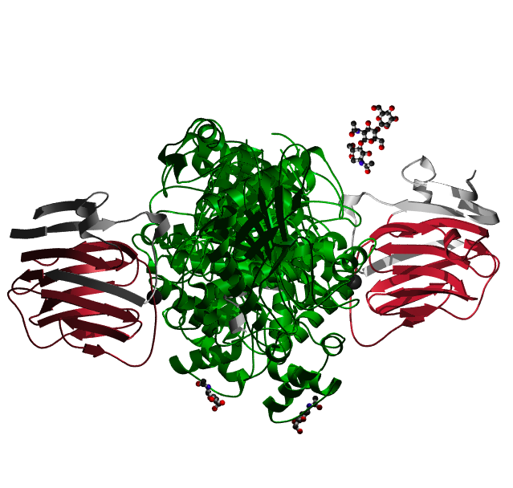
Laminin G domain

Slide 22
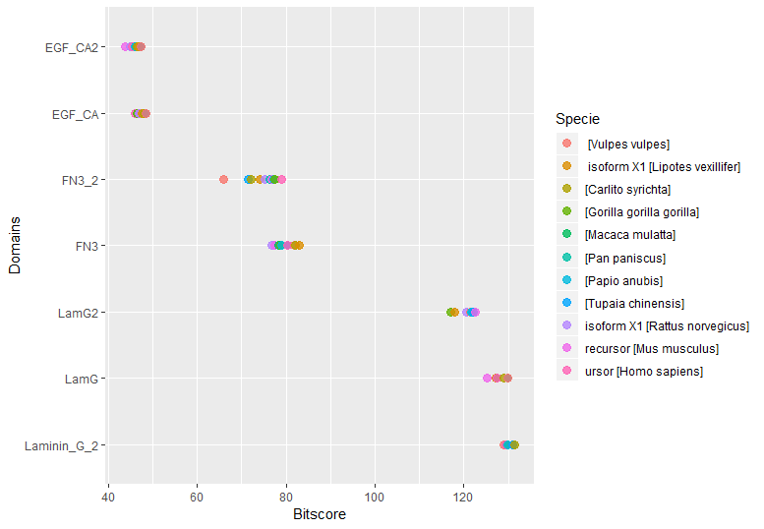

Slide 23
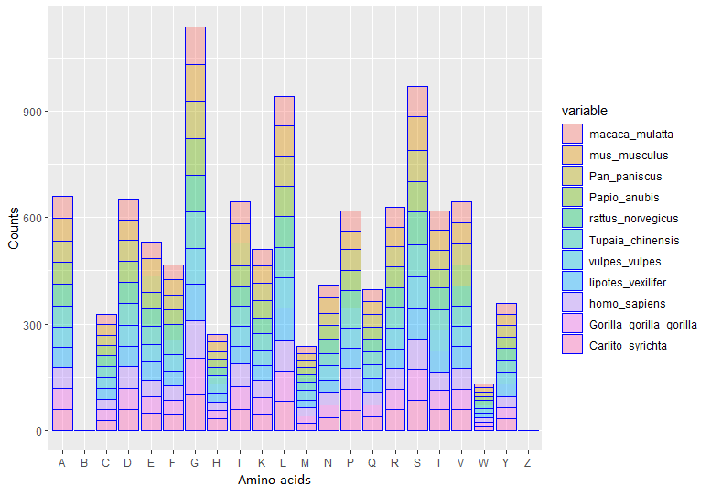

Slide 24


Slide 25




Slide 26



Slide 27


Slide 28
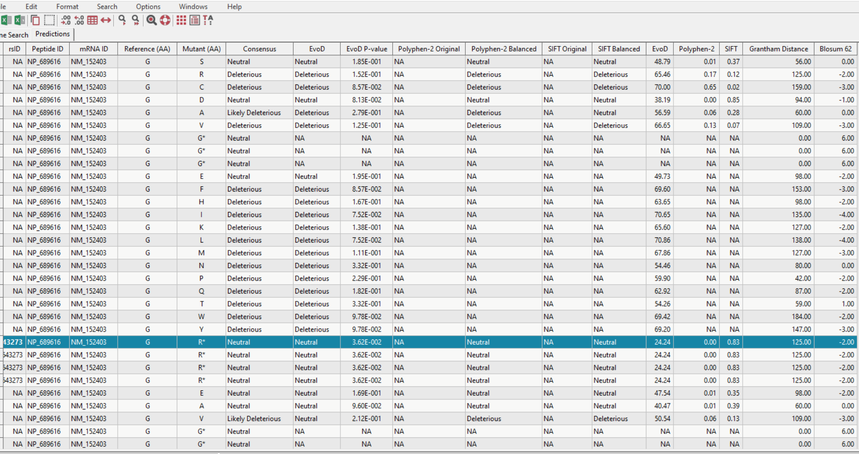

Slide 29
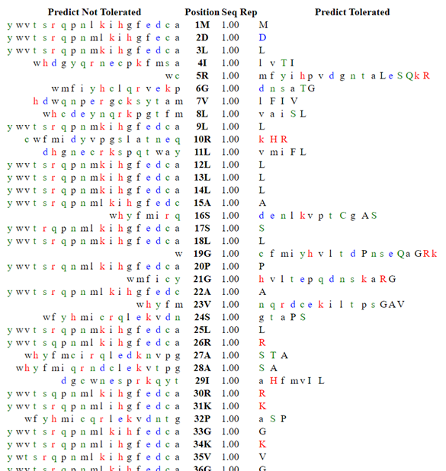
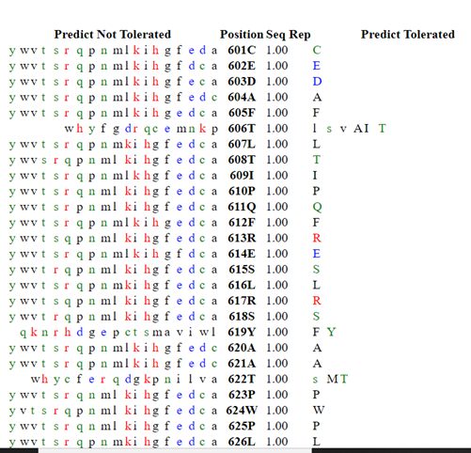

Slide 30

Acknowledgements
Thanks a lot to Pokémon which makes us able to work on this project and protein!
Thanks to Ogün hoca for letting us work on this protein!
Thank you for listening!

Slide 31
References
“Egflam EGF-like, Fibronectin Type III and Laminin G Domains [Mus Musculus (House Mouse)] - Gene - NCBI.” National Center for Biotechnology Information, U.S. National Library of Medicine, https://www.ncbi.nlm.nih.gov/gene?Db=gene&Cmd=DetailsSearch&Term=268780.
“Family: EGF_CA (PF07645).” Pfam, https://pfam.xfam.org/family/EGF_CA.
“Family: fn3 (PF00041).” Pfam, http://pfam.xfam.org/family/PF00041.21.
Adebali, O., Ortega, D. R., & Zhulin, I. B. (2015). CDvist: A webserver for identification and visualization of conserved domains in protein sequences. Bioinformatics, 31(9), 1475–1477. https://doi.org/10.1093/bioinformatics/btu836
Cell Specific Processing Of Pikachurin, A Protein Involved In Retinal Synaptogenesis | IOVS | ARVO Journals. (n.d.). Retrieved December 15, 2019, from https://iovs.arvojournals.org/article.aspx?articleid=2358039
Common Taxonomy Tree. (n.d.). Retrieved December 15, 2019, from https://www.ncbi.nlm.nih.gov/Taxonomy/CommonTree/wwwcmt.cgi
EGFLAM - Pikachurin precursor - Homo sapiens (Human) - EGFLAM gene & protein. (n.d.). Retrieved December 15, 2019, from https://www.uniprot.org/uniprot/Q63HQ2
Omori, Yoshihiro, et al. “Presynaptic Dystroglycan–Pikachurin Complex Regulates the Proper Synaptic Connection between Retinal Photoreceptor and Bipolar Cells.” Journal of Neuroscience, Society for Neuroscience, 2 May 2012, https://www.jneurosci.org/content/32/18/6126.
PFAM, https://pfam.xfam.org/family/EGF_CA.

Slide 32
References
Omori, Yoshihiro, et al. “Presynaptic Dystroglycan–Pikachurin Complex Regulates the Proper Synaptic Connection between Retinal Photoreceptor and Bipolar Cells.” Journal of Neuroscience, Society for Neuroscience, 2 May 2012, https://www.jneurosci.org/content/32/18/6126.
PFAM, https://pfam.xfam.org/family/EGF_CA.
RCSB PDB - Protein Feature View - Pikachurin - Q63HQ2 (EGFLA_HUMAN). (n.d.). Retrieved December 15, 2019, from http://www.rcsb.org/pdb/protein/Q63HQ2
RCSB Protein Data Bank. “Pikachurin - Q63HQ2 (EGFLA_HUMAN).” RCSB PDB - Protein Feature View - Pikachurin - Q63HQ2 (EGFLA_HUMAN), http://www.rcsb.org/pdb/protein/Q63HQ2?evtc=Suggest&evta=ProteinFeature View&evtl=autosearch_SearchBar_querySuggest.
Sato, S., Omori, Y., Katoh, K., Kondo, M., Kanagawa, M., Miyata, K., … Furukawa, T. (2008). Pikachurin, a dystroglycan ligand, is essential for photoreceptor ribbon synapse formation. Nature Neuroscience, 11(8), 923–931. https://doi.org/10.1038/nn.2160
The ConSurf Server. (n.d.). Retrieved December 15, 2019, from http://consurf.tau.ac.il/index_nucleotides.php
Welcome to NCBI Batch CD-search. (n.d.). Retrieved December 15, 2019, from https://www.ncbi.nlm.nih.gov/Structure/bwrpsb/bwrpsb.cgi

Slide 33

Questions

